Slide 1
Decentralized Cab Service: Blockchain - Ethereum
CS 237: Distributed Systems Middleware
Avinash Nath Aita (aaita)
Kanika Baijal (kbaijal)

Slide 2
Motivation & Goals
Decentralized approach - Why?
Transparency
Verifiability and Trust
Cost model
Surge Pricing Vs User-driven (User = Driver)
Freedom of Choice
Policy driven
Example: Priority - Least price / Least wait time / Highest rating
User driven (User = Rider)
Choose among available options on request
Goals: Achieve trust and freedom of choice (Rider and Driver) without relying on a 3rd party Note: Requires 1 trusted policy(/party) for default price (between chosen source and destination)

Slide 3
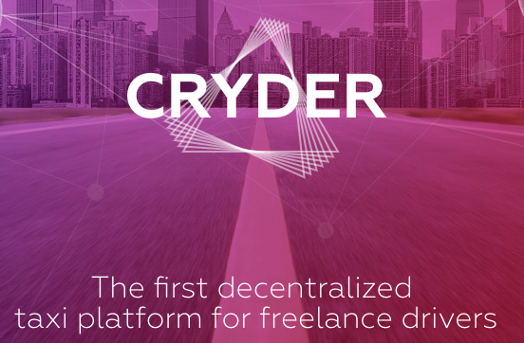
Related Work
Bitcoin?
Ethereum?
All the decentralized applications - (dapp)
Academic / Fun projects - https://www.stateofthedapps.com/
Existing implementations?
Cryder
Arcade city
Red cab

Slide 4
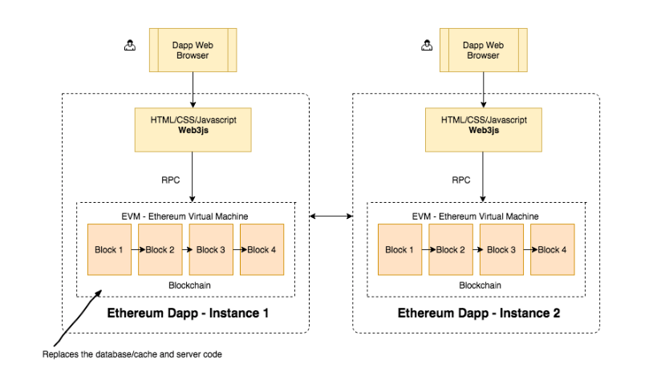
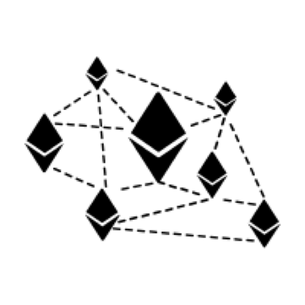
Decentralized App (not feasible)
Rider
Driver
Decentralized app running on every node (rider &driver)

Slide 5
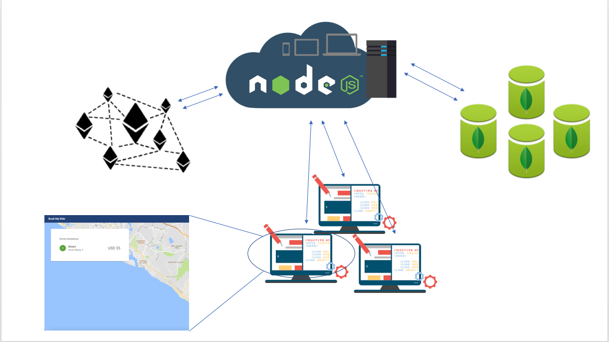
Architecture
Co-ordinator - can be multiplexed with every user to achieve decentralization model
(Open sourced)
Blockchain distributed ledger - store critical information
DB - Store all the required information that scales the requests
GUI
Requests by Users - (Rider and Driver)

Slide 6
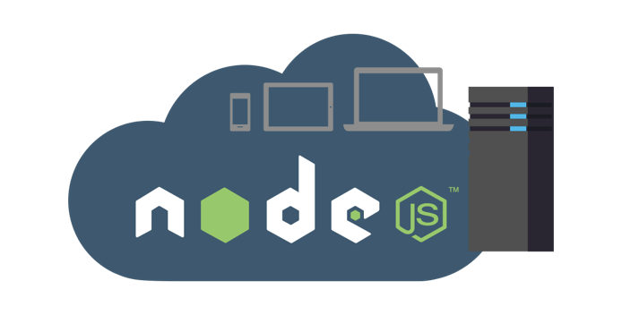

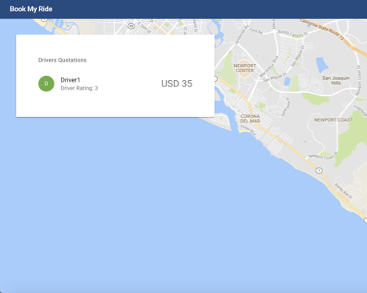
Components
Deploy contract
Provide API
Transparency
Store on MongoDB
Contract (Solidity)
Collections
Riders
Drivers
Ride_Requests
Quotations
Dapp UI
Riders select
Drivers quote
Notes:
Note: The Dapp can currently be separately on every node as well for the API part (UI integration was left out)
The nodes running the business logic can be anywhere - with the users or in the cloud or anywhere

Slide 7
Testing flow
Testing Use Case:
A Rider 1 requests a ride from Loc A (source) to Loc B(Destination)
Another Rider 2 requests a ride from Loc A to Loc C
There are two drivers Driver 1 and Driver 2 at nearby locations of Loc A which is the pickup location of both the riders

Slide 8
The application works as follows:
As both the drivers login with their driverIds, and enter their current location, their location gets updated in the Driver collection of Mongodb using the updateLoc api
Riders login to their respective applications using the riderIds and book rides from source to destination, rider travel details are updated in the Ride_Request table. Following that using each of the riders src latitude and longitude values, nearest drivers to the rider are retrieved using geospatial queries of Mongodb.
These details are updated in the quotations table, with a request_id and driver_id.
The drivers continuously poll the quotations table for any nearby riders.
At the same time, riders continuously poll for nearby drivers.

Slide 9
Once the Drivers get the nearby riders, there is a base price which appears along with each request. They are allowed to quote an about over that.
The quoted amount appears to the rider.
The rider can choose any of the Drivers based on the quoted amount, and the status of the Driver is updated to ‘Selected’.
Once chosen, a confirmation goes to the driver to confirm the ride, and the booking is successful and the Driver status is updated to ‘Busy’.
Three Transparency APIs exposed provide the functionality to verify the critical details in the transactions involved in the blockchain.
Getting all quotation details of a request
Getting all request details of a request
Total Requests

Slide 10
Thank you!

Slide 11
Specifics
Rider APIs
Registration of a new rider: /api/v4/register/rider
Creating a ride request : /api/v1/rider/createNewRequest?rid=x
Poll quotations for created ride request: /api/v2/rider/pollQuotations
Select final quotation - for a rider: /api/v2/rider/selectRide
Driver APIs
Register Driver - /api/v4/register/driver
Driver update location - /api/v2/driver/updateLocation
Poll nearby rides for a rider : /api/v2/driver/pollRides
Add a quotation for a ride - by a driver - /api/v2/driver/addQuotation
Blockchain APIs:
Getting all quotation details of a request: /api/v1/getAllQuotationDetails
Getting all request details of a request : /api/v1/getReqDetails
Total Requests: /v1/getTotalNumReqs

Slide 12
MongoDB Collections:
Drivers:{ _id, driver_name,status,driver_rating,driver_car, curr_location}
Riders:{_id,rider_name}
Ride_Request{ _id, rider_id , src_lat , src_lon, des_lat , des_lon, Quote}
Quotations { _id, driver_id, req_id, quote_amount}

